Slide 1
Data and Method
            Research question
            Data collection & analysis
            Research Significance

Slide 2
RQ: Why do people believe in election fraud theory?
2020 general election
Independent Variable
Dependent Variable
Age
Ignorance
Cognitive reflection
Factual political knowledge
Belief in election fraud theory
Dissatisfaction
Perceived immorality
Perceived incompetence
Partisanship
Polarization
Out-party emotion

Slide 3
Procedure
Step 1: Questionnaire
Step 2: Factor analysis
Step 3: Correlation
Step 4: Regression

Slide 4
Procedure
Step 1: Questionnaire
  Design
    Survey Monkey
    Altogether 50 questions
  Distribution
    Pilot survey
    Snowball sampling
    December 2022
    N=100
Step 2: Factor analysis
Step 3: Correlation
Step 4: Regression

Slide 5
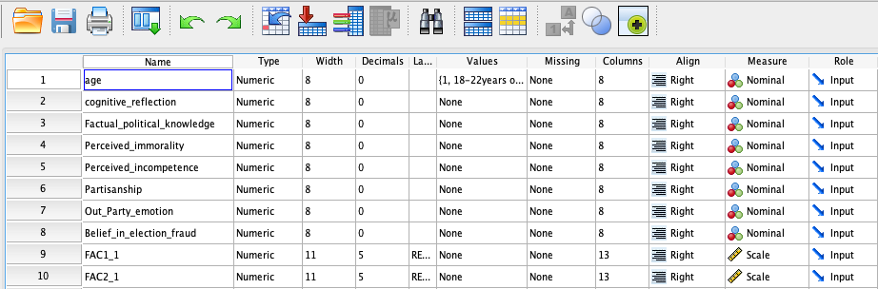
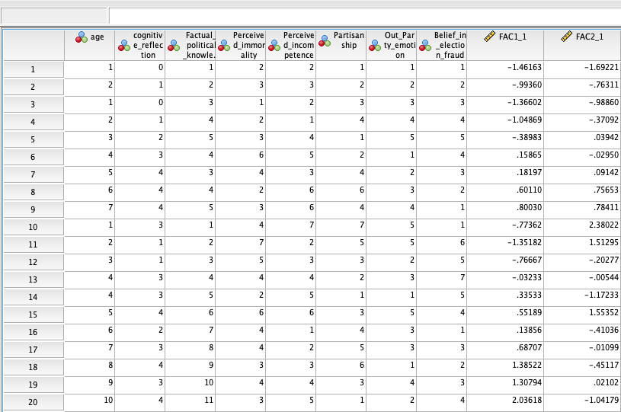
Procedure
Step 1: Questionnaire
  Design
    Survey Monkey
    Altogether 50 questions
  Distribution
    Pilot survey
    Snowball sampling
    December 2022
    N=100
Step 2: Factor analysis
Step 3: Correlation
Step 4: Regression

Slide 6
Procedure
Step 1: Questionnaire
  Design
    Survey Monkey
    Altogether 50 questions
  Distribution
    Pilot survey
    Snowball sampling
    December 2022
    N=100
Step 2: Factor analysis
Step 3: Correlation
Step 4: Regression

Slide 7
Procedure
Step 1: Questionnaire
  Design
    Survey Monkey
    Altogether 50 questions
  Distribution
    Pilot survey
    Snowball sampling
    December 2022
    N=100
Step 2: Factor analysis
Step 3: Correlation
Step 4: Regression

Slide 8
Procedure
Step 1: Questionnaire
  Design
    Survey Monkey
    Altogether 50 questions
  Distribution
    Pilot survey
    Snowball sampling
    December 2022
    N=100
Step 2: Factor analysis
Step 3: Correlation
Step 4: Regression

Slide 9
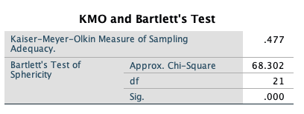
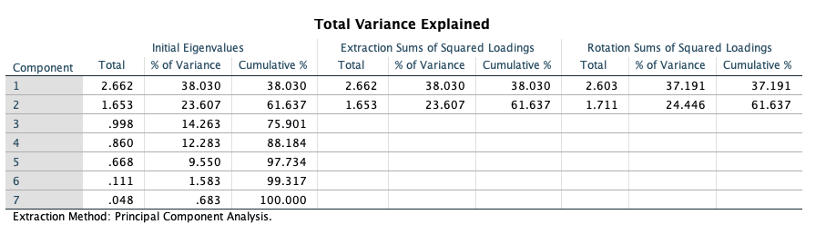
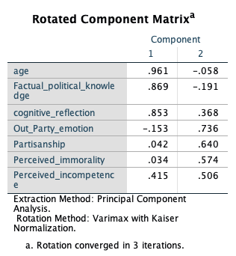
Procedure
Step 1: Questionnaire
Step 2: Factor analysis
  To reduce variables into factors
  Varimax: independent
  KMO and Bartlett’s Test>0.5?
  Factors with eigenvalue>1?
  Components of new factors
  3 factors are expected
Step 3: Correlation
Step 4: Regression

Slide 10
Procedure
Step 1: Questionnaire
Step 2: Factor analysis
  To reduce variables into factors
  Varimax: independent
  KMO and Bartlett’s Test>0.5?
  Factors with eigenvalue>1?
  Components of new factors
  3 factors are expected
Step 3: Correlation
Step 4: Regression

Slide 11
Procedure
Step 1: Questionnaire
Step 2: Factor analysis
  To reduce variables into factors
  Varimax: independent
  KMO and Bartlett’s Test>0.5?
  Factors with eigenvalue>1?
  Components of new factors
  3 factors are expected
Step 3: Correlation
Step 4: Regression

Slide 12
Procedure
Step 1: Questionnaire
Step 2: Factor analysis
  To reduce variables into factors
  Varimax: independent
  KMO and Bartlett’s Test>0.5?
  Factors with eigenvalue>1?
  Components of new factors
  3 factors are expected
Step 3: Correlation
Step 4: Regression

Slide 13
Procedure
Step 1: Questionnaire
Step 2: Factor analysis
  To reduce variables into factors
  Varimax: independent
  KMO and Bartlett’s Test>0.5?
  Factors with eigenvalue>1?
  Components of new factors
  3 factors are expected
Step 3: Correlation
Step 4: Regression

Slide 14
Procedure
Step 1: Questionnaire
Step 2: Factor analysis
Step 3: Correlation
  Parallel to factor analysis
  To check the relationships between variables
  To make sure multiple regression is worthwhile
  Correlation Matrix
Step 4: Regression

Slide 15
Step 3: Simple Correlation Coefficients (r) between Research variables
 | 1 | 2 | 3 | 4 | 5 | 6 | 7 | 8
IGNORANCE
1. Age | 1.00
2. Cognitive Reflection |  | 1.00
3. Factual Political knowledge |  |  | 1.00
DISSATISFACTION
4. Perceived immorality |  |  |  | 1.00
5. Perceived incompetence |  |  |  |  | 1.00
POLARIZATION
6. Partisanship |  |  |  |  |  | 1.00
7. Out-Party Emotion |  |  |  |  |  |  | 1.00
BELIEF IN ELECTION FRAUD
8. Belief in election fraud |  |  |  |  |  |  |  | 1.00

Slide 16
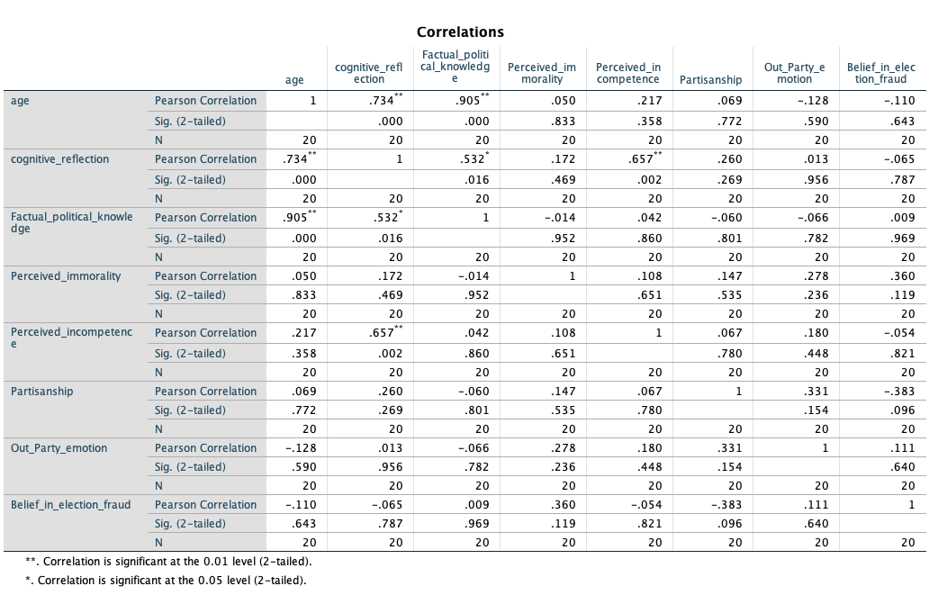
Step 3: Simple Correlation Coefficients (r) between Research variables
 | 1 | 2 | 3 | 4 | 5 | 6 | 7 | 8
IGNORANCE
1. Age | 1.00
2. Cognitive Reflection |  | 1.00
3. Factual Political knowledge |  |  | 1.00
DISSATISFACTION
4. Perceived immorality |  |  |  | 1.00
5. Perceived incompetence |  |  |  |  | 1.00
POLARIZATION
6. Partisanship |  |  |  |  |  | 1.00
7. Out-Party Emotion |  |  |  |  |  |  | 1.00
BELIEF IN ELECTION FRAUD
8. Belief in election fraud |  |  |  |  |  |  |  | 1.00

Slide 17
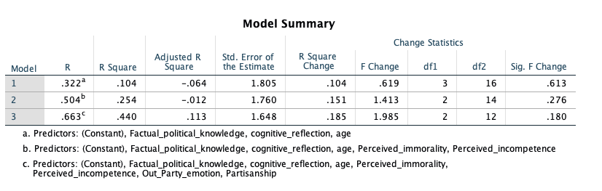
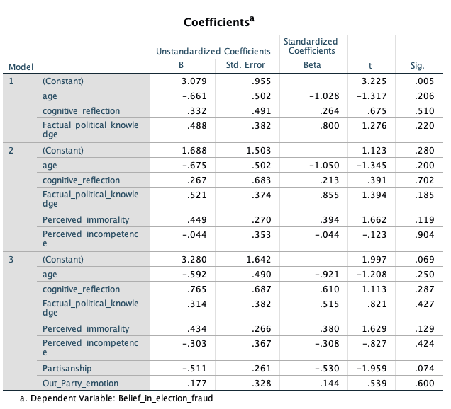
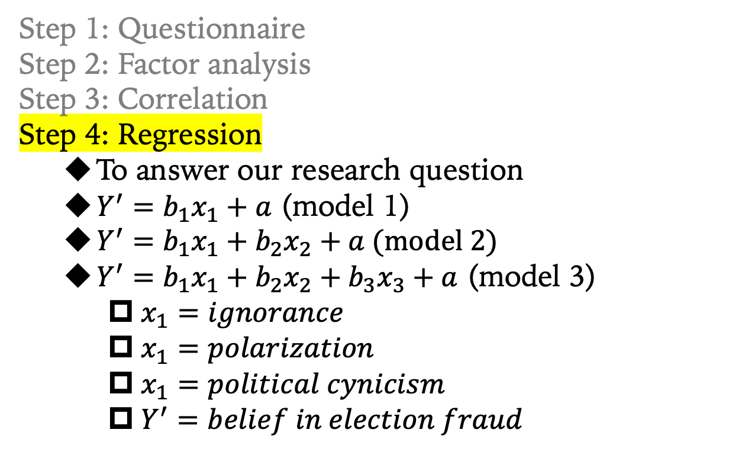
Procedure
Step 1: Questionnaire
Step 2: Factor analysis
Step 3: Correlation
Step 4: Regression
  To answer our research question
  $Y^{′}=b_{1}x_{1}+a$ (model 1)
  $Y^{′}=b_{1}x_{1}+b_{2}x_{2}+a$ (model 2)
  $Y^{′}=b_{1}x_{1}+b_{2}x_{2}+b_{3}x_{3}+a$ (model 3)
    $x_{1}=ignorance$
    $x_{1}=polarization$
    $x_{1}=political cynicism$
    $Y^{′}=belief in election fraud$

Slide 18
Procedure
Step 1: Questionnaire
Step 2: Factor analysis
Step 3: Correlation
Step 4: Regression
  To answer our research question
  $Y^{′}=b_{1}x_{1}+a$ (model 1)
  $Y^{′}=b_{1}x_{1}+b_{2}x_{2}+a$ (model 2)
  $Y^{′}=b_{1}x_{1}+b_{2}x_{2}+b_{3}x_{3}+a$ (model 3)
    $x_{1}=ignorance$
    $x_{1}=polarization$
    $x_{1}=political cynicism$
    $Y^{′}=belief in election fraud$

Slide 19
Procedure
Step 1: Questionnaire
Step 2: Factor analysis
Step 3: Correlation
Step 4: Regression
  To answer our research question
  $Y^{′}=b_{1}x_{1}+a$ (model 1)
  $Y^{′}=b_{1}x_{1}+b_{2}x_{2}+a$ (model 2)
  $Y^{′}=b_{1}x_{1}+b_{2}x_{2}+b_{3}x_{3}+a$ (model 3)
    $x_{1}=ignorance$
    $x_{1}=polarization$
    $x_{1}=political cynicism$
    $Y^{′}=belief in election fraud$

Slide 20
Research Significance
Adds to literature on election fraud
  3 theories
  quantitative study method
Measures to dissolve the myth of election fraud
  Transparency rather than secret ballot?
  Stricter voter registration rules?
  Or
  Political education/socialization
  Finding common ground and reduce polarization
  A better system with higher levels of morality and competence

