Slide 1
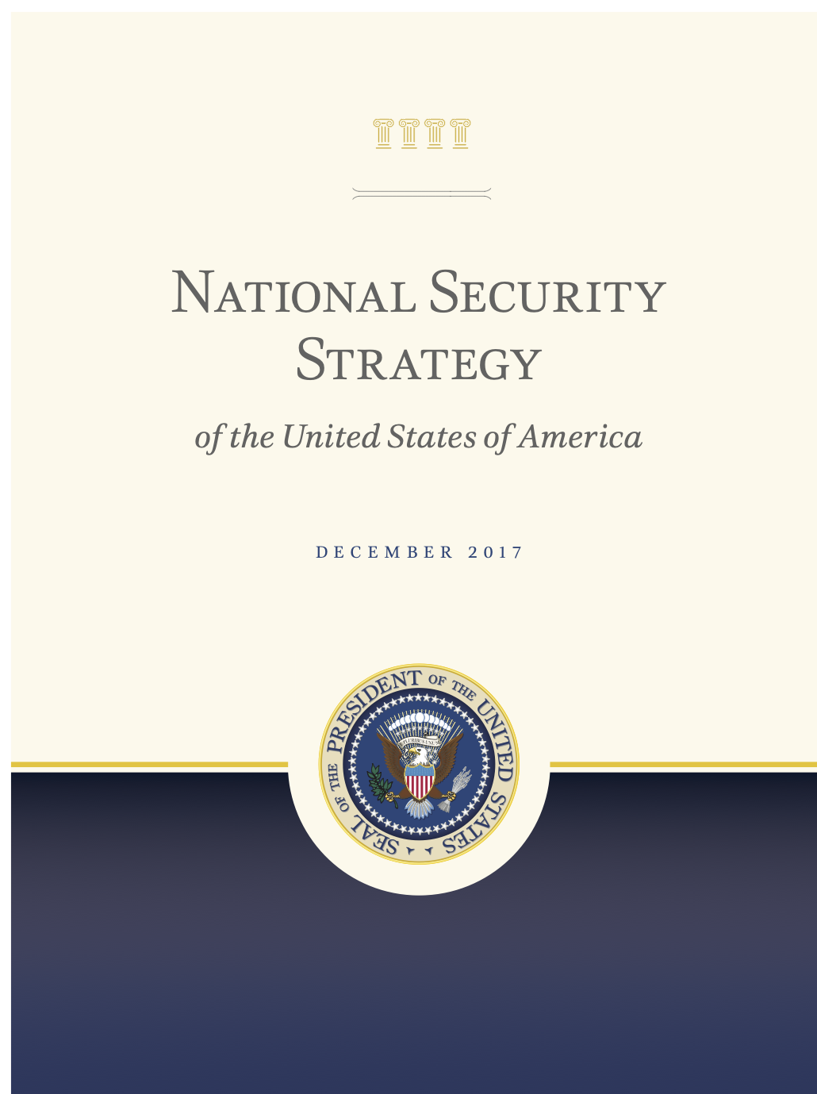
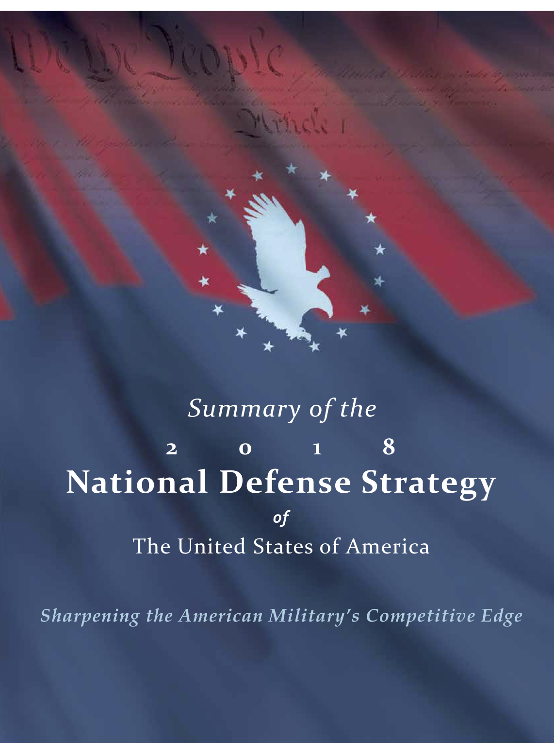
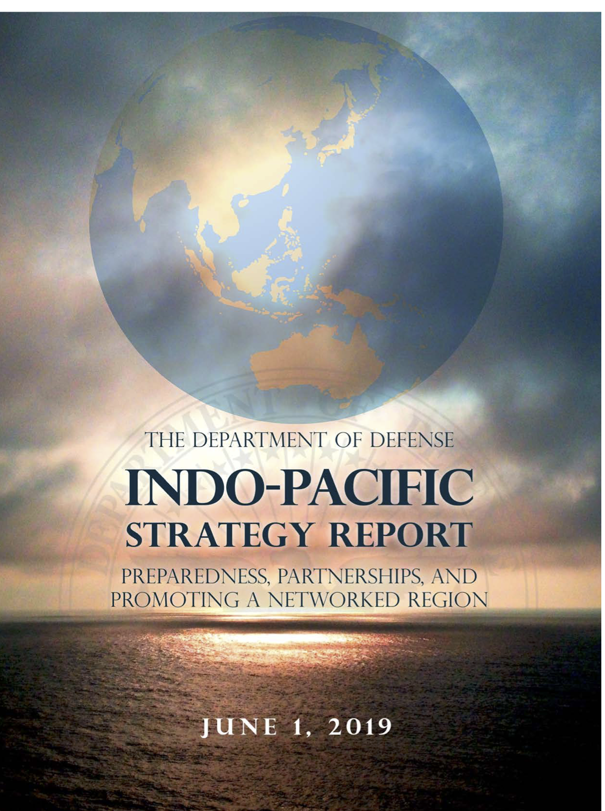
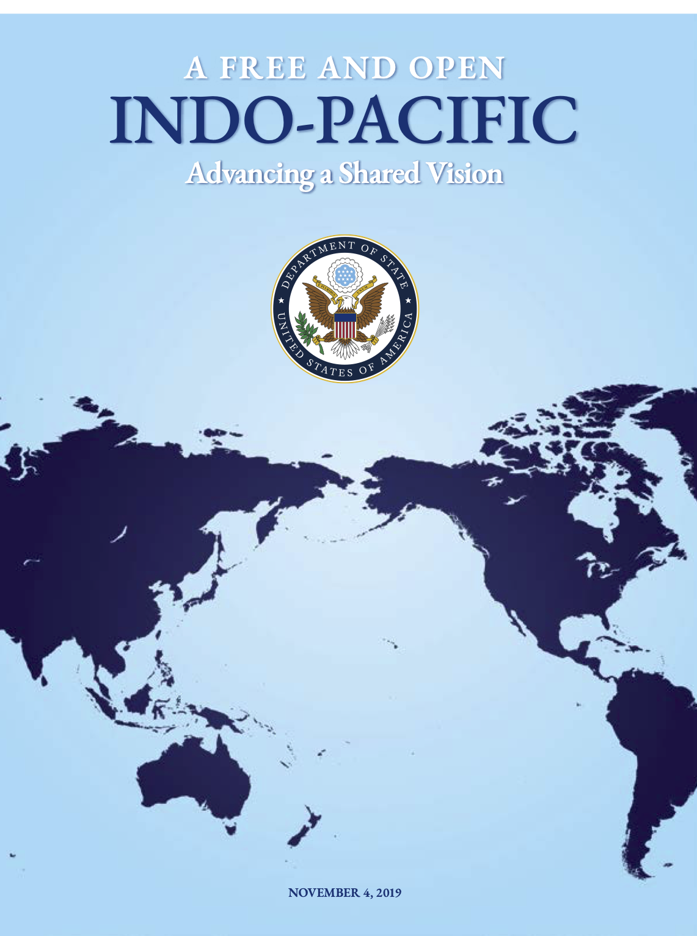
TRUMP AND THE INDO-PACIFIC
Presented by ZHANG Wei
September 29, 2022

Slide 2
NATIONAL SECURITY STRATEGY 2017
NATIONAL DEFENSE
STRATEGY 2018
INDO-PACIFIC STRATEGY REPORT
2019
A FREE AND OPEN INDO-PACIFIC
2019
TRUMP AND THE INDO-PACIFIC
Presented by ZHANG Wei
September 29, 2022

Slide 3
TRUMP AND THE INDO-PACIFIC
Q1: What is Trump’s Indo-Pacific strategy?

Slide 4
TRUMP AND THE INDO-PACIFIC
Q1: What is Trump’s Indo-Pacific strategy?
Q2: How is it different from or similar with its predecessor?

Slide 5
TRUMP AND THE INDO-PACIFIC
Q1: What is Trump’s Indo-Pacific strategy?
Q2: How is it different from or similar with its predecessor?
Q3: What are its achievements and problems?

Slide 6
 |  | Grossman (2021) | Bisley (2020) | Patel &Hansmeyer (2020) | Patel and Hansmeyer((2020)
Compared with Obama’s |  | Continuity | Continuity | Change | Change
Objective& Strategy | To preserve American primacy in the Indo-Pacific
Objective& Strategy | Security | free and open from coercion; | ”Maximum Pressure” (crisis management) |  | A transactional approach maximizing gains while shifting risks to others
 | Governance | transparent governance | from liberal internationalism to realpolitik
 | Economics | improving market access | mercantilism
Implementation | Problem | divergence | inertia, no alternative |  | the win-lose outcome
 | Achievement | Quad, FONOPs | ---

Slide 7
Grossman (2021)
Grossman
Bisley
Patel &Hansmeyer
Synthesis
✅
Main arguments
Trump’s Indo-Pacific strategy is in fact very similar to Obama’s pivot to Asia, with only more explicit emphasis on containing China. (195)
The implementation of this strategy is overall successful, in that Indo-Pacific countries are willing to endure pressure from Trump and neglect his missteps for greater economic and security gains. (200)

Slide 8
Grossman (2021)
Grossman
Bisley
Patel &Hansmeyer
Synthesis
✅
1) Trump’s Adoption of the FOIP concept
Adoption
Most likely influenced by Shinzo Abe (189)
Less likely due to domestic political competition or US military thinking (190)
Adaptation
“from the American to Indian west coast” (190)
“from California to Mount Kilimanjaro” (191)
Why evolving? --- to align his conception with that of his allies (191)

Slide 9
Grossman (2021)
Grossman
Bisley
Patel &Hansmeyer
Synthesis
✅
1) Trump’s Adoption of the FOIP concept
Adoption
Most likely influenced by Shinzo Abe (189)
Less likely due to domestic political competition or US military thinking (190)
Adaptation
“from the American to Indian west coast” (190)
“from California to Mount Kilimanjaro” (191)
Why evolving? --- to align his conception with that of his allies (191)

Slide 10
Grossman (2021)
Grossman
Bisley
Patel &Hansmeyer
Synthesis
✅
2) Trump’s Objective & Strategy
Security level: To keep the IP free and open from (Chinese) coercion
Free = the sovereignty of all states ne respected (193)
Open = connectivity of & open access to the region, esp. FONOPs (193)
Non-security level: To preserve the liberal, rule-based international order
Linkages between economics, governance, and security (193)
Governance = “light-touch regulation that foster entrepreneurship and the efficient allocation of capital” (194)
Economics = “free enterprise” , “market access”, “resist coercive economic practices, unsustainable debt burdens” (195)

Slide 11
Grossman (2021)
Grossman
Bisley
Patel &Hansmeyer
Synthesis
✅
2) Trump’s Objective & Strategy
Security level: To keep the IP free and open from (Chinese) coercion
Free = the sovereignty of all states ne respected (193)
Open = connectivity of & open access to the region, esp. FONOPs (193)
Non-security level: To preserve the liberal, rule-based international order
Linkages between economics, governance, and security (193)
Governance = “light-touch regulation that foster entrepreneurship and the efficient allocation of capital” (194)
Economics = “free enterprise” , “market access”, “resist coercive economic practices, unsustainable debt burdens” (195)

Slide 12
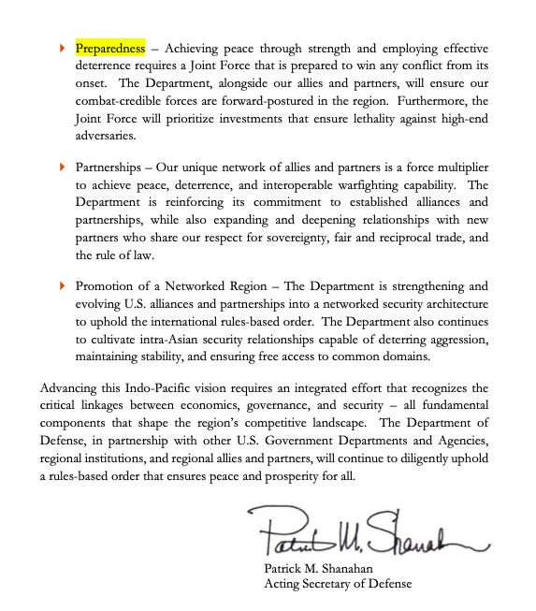
Grossman (2021)
Grossman
Bisley
Patel &Hansmeyer
Synthesis
✅
2) Trump’s Objective & Strategy
DoD, Indo-Pacific Strategy report
3Ps: Preparedness, Partnership, Promoting a Networked region (194)

Slide 13
Grossman (2021)
The Administration’s strategy
Grossman
Bisley
Patel &Hansmeyer
Synthesis
✅
Trump’s words and actions
3) Implementation
Problems:
The divergence between the administration’s strategy and Trump’s words and actions (196)
Japan, India, Vietnam: security cooperation paralleled economic pressure (196-197)
South Korea (Special Measures Agreement) (197)
Philippine (Visiting Forces Agreement) (197)
The BUILD Act not much substantial influence (199)
The Reputational cost of not sending higher level officials to East Asia Summit and ASEAN Regional Forum
Achievements

Slide 14
Grossman (2021)
The Administration’s strategy
Grossman
Bisley
Patel &Hansmeyer
Synthesis
✅
Trump’s words and actions
3) Implementation
Problems:
The divergence between the administration’s strategy and Trump’s words and actions (196)
Japan, India, Vietnam: security cooperation paralleled economic pressure (196-197)
South Korea (Special Measures Agreement) (197)
Philippine (Visiting Forces Agreement) (197)
The BUILD Act not much substantial influence (199)
The Reputational cost of not sending higher level officials to East Asia Summit and ASEAN Regional Forum
Achievements

Slide 15
Grossman (2021)
The Administration’s strategy
Grossman
Bisley
Patel &Hansmeyer
Synthesis
✅
Trump’s words and actions
3) Implementation
Problems:
The divergence between the administration’s strategy and Trump’s words and actions (196)
The BUILD Act not much substantial influence (199)
American counterpart of China’s BRI
Overemphasizing security while neglecting economics (199)
The Reputational cost of not sending higher level officials to East Asia Summit and ASEAN Regional Forum
Robert O’Brian, National Security Advisor
Southeast Asia is believed to be the center of US-China competition
Achievements

Slide 16
Grossman (2021)
The Administration’s strategy
Grossman
Bisley
Patel &Hansmeyer
Synthesis
✅
Trump’s words and actions
3) Implementation
Problems:
The divergence between the administration’s strategy and Trump’s words and actions (196)
The BUILD Act not much substantial influence (199)
The Reputational cost of not sending higher level officials to East Asia Summit and ASEAN Regional Forum
Robert O’Brian, National Security Advisor
Southeast Asia is believed to be the center of US-China competition
Achievements

Slide 17
Grossman (2021)
Grossman
Bisley
Patel &Hansmeyer
Synthesis
✅
3) Implementation
Problems
Achievements
“Indo” powers (traditional allies/partners) + “pacific” powers (Freely Associated States, giving the US military access to their territory) (198)
The resurrection of the Quadrilateral Security Dialogue (Quad), the enhanced Quad Plus (198)
More FONOPs that complicated China’s sovereignty claim in the South China Sea (198)
Overall Successful: “Indo-Pacific countries similarly need Washington and are likely to look past US missteps so long as it supports their national security strategies” (200)

Slide 18
Grossman (2021)
Grossman
Bisley
Patel &Hansmeyer
Synthesis
✅
3) Implementation
Problems
Achievements
“Indo” powers (traditional allies/partners) + “pacific” powers (Freely Associated States, giving the US military access to their territory) (198)
The resurrection of the Quadrilateral Security Dialogue (Quad), the enhanced Quad Plus (198)
More FONOPs that complicated China’s sovereignty claim in the South China Sea (198)
Overall Successful: “Indo-Pacific countries similarly need Washington and are likely to look past US missteps so long as it supports their national security strategies” (200)

Slide 19
Grossman (2021)
Grossman
Bisley
Patel &Hansmeyer
Synthesis
✅
3) Implementation

Slide 20
Grossman (2021)
Grossman
Bisley
Patel &Hansmeyer
Synthesis
✅
3) Implementation

Slide 21
Grossman (2021)
Grossman
Bisley
Patel &Hansmeyer
Synthesis
✅
3) Implementation

Slide 22
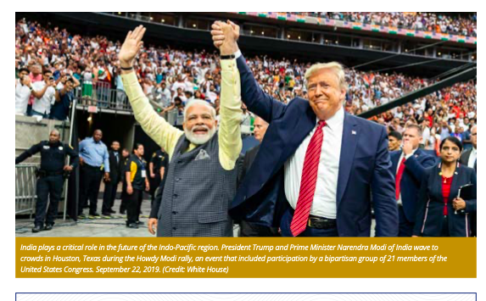
Grossman (2021)
Grossman
Bisley
Patel &Hansmeyer
Synthesis
✅
3) Implementation

Slide 23
Grossman (2021)
Grossman
Bisley
Patel &Hansmeyer
Synthesis
✅
4) Policy Prescriptions (201-202)
Resolve the divergence
Avoid extreme action, dealing with China in ways that suit the interests of other allies/partners as well
Provide substantial funding
Forge bilateral trade agreements or rejoin the TPP
Diversify the US role in this region

Slide 24
Bisley (2020)
Grossman
Bisley
Patel &Hansmeyer
Synthesis
✅
Main arguments
Trump’s Indo-Pacific strategy shows continuity with former Pivot to Asia strategy and it is exacerbating the long-term trend of China’s growing assertiveness and America’s declining credibility (161, 172-173).
Despite its verbal emphasis on Indo-Pacific, it is actually very negligent/inertial and a-strategic, fixating on limited regional security and short-sighted mercantilist economic relations and equipped with limited resources (162, 167, 172).

Slide 25
Bisley (2020)
Grossman
Bisley
Patel &Hansmeyer
Synthesis
✅
1) Obama’s Rebalance to Asia
Resulted from
the awareness that the Bush administration put too much emphasis on the Middle East at the expense of US interests in the Asia Pacific (163)
Aims & Means
To Distribute US resources according to the target’s strategic significance (163)
To retain US preponderance in this region and to contain China
To promote multilateralism to connect economic interests with security interests (164).

Slide 26
Bisley (2020)
Grossman
Bisley
Patel &Hansmeyer
Synthesis
✅
1) Obama’s Rebalance to Asia
Resulted from
Aims & Means (163-165)
To Distribute US resources according to the target’s strategic significance
Iraq and Afghanistan were given too much emphasis they don’t deserve
To retain US preponderance in this region and to contain China
“China’s dramatic growth was fundamentally changing the region” (164)
To prioritize Asia-Pacific issues
“To devote more military assets to the region” (164)
To promote multilateralism to connect economic interests with security interests (164).
Engagement in EAS, APEC, ASEAN, TPP

Slide 27
Bisley (2020)
Grossman
Bisley
Patel &Hansmeyer
Synthesis
✅
1) Obama’s Rebalance to Asia
Resulted from
Aims & Means (163-165)
To Distribute US resources according to the target’s strategic significance
Iraq and Afghanistan were given too much emphasis they don’t deserve
To retain US preponderance in this region and to contain China
“China’s dramatic growth was fundamentally changing the region” (164)
To prioritize Asia-Pacific issues
“To devote more military assets to the region” (164)
To promote multilateralism to connect economic interests with security interests (164).
Engagement in EAS, APEC, ASEAN, TPP

Slide 28
Bisley (2020)
Grossman
Bisley
Patel &Hansmeyer
Synthesis
✅
1) Obama’s Rebalance to Asia
Resulted from
Aims & Means (163-165)
To Distribute US resources according to the target’s strategic significance
Iraq and Afghanistan were given too much emphasis they don’t deserve
To retain US preponderance in this region and to contain China
“China’s dramatic growth was fundamentally changing the region” (164)
To prioritize Asia-Pacific issues
“To devote more military assets to the region” (164)
To promote multilateralism to connect economic interests with security interests (164).
Engagement in EAS, APEC, ASEAN, TPP

Slide 29
Bisley (2020)
Grossman
Bisley
Patel &Hansmeyer
Synthesis
✅
2) Trump’s Asia Policy
Continuity
Security relations with China; support for One China policy (167)
Engagement with regional institutions; 2017 APEC meetings (168)
Change
China policy: China depicted as a geopolitical rival (168)
North Korea: from “strategic patience” to “Maximum Pressure” (169)
Trade policy: mercantilist thinking (169-170)
Philosophically: from liberal internationalism to realpolitik (169-170)

Slide 30
Bisley (2020)
Grossman
Bisley
Patel &Hansmeyer
Synthesis
✅
2) Trump’s Asia Policy
Continuity
Security relations with China; support for One China policy (167)
Engagement with regional institutions; 2017 APEC meetings (168)
Change
China policy: China depicted as a geopolitical rival (168)
North Korea: from “strategic patience” to “Maximum Pressure” (169)
Trade policy: mercantilist thinking (169-170)
Philosophically: from liberal internationalism to realpolitik (169-170)

Slide 31
Bisley (2020)
Grossman
Bisley
Patel &Hansmeyer
Synthesis
✅
3) Implementation: continuity > change
The inertial qualities of the US government
The divide within the Republican party between orthodox Republicans and nativist Trumpian Republicans (171)
The absence of alternative US security policy in Asia
Most of the alleged alternatives turned out to be mere rhetoric (171).
The Long term trend continues

Slide 32
Bisley (2020)
Grossman
Bisley
Patel &Hansmeyer
Synthesis
✅
3) Implementation: continuity > change
The inertial qualities of the US government
The absence of alternative US security policy in Asia
Most of the alleged alternatives turned out to be mere rhetoric (171).
The Long term trend continues

Slide 33
Bisley (2020)
Grossman
Bisley
Patel &Hansmeyer
Synthesis
✅
3) Implementation: continuity > change
The inertial qualities of the US government
The absence of alternative US security policy in Asia
The Long term trend continues
Starting from Bush Jr.,
“China’s growing power and assertiveness” (incompatible)
“Uncertainty about American influence and purpose” (rebalance but compatible; acted as nothing had changed)
Unsettled the Indo-Pacific region

Slide 34
Patel and Hansmeyer (2020)
Grossman
Bisley
Patel &Hansmeyer
Synthesis
✅
Main arguments
The Trump administration replaces Obama’s multilateralism and engagement strategy with a transactional approach maximizing its own gains while shifting risk to others, which risks hurting its long held strategic leadership position for only a short-term victory (210, 222)

Slide 35
Patel and Hansmeyer (2020)
Grossman
Bisley
Patel &Hansmeyer
Synthesis
✅
1) Obama’s Asia Pivot
Initiatives (211)
“Driving regional economic integration” (TPP)
“Checking Chinese territorial expansion with FONOPs”
“Engaging with India to build a counter-weight to China”
Goal: To maintain US presence in this region and to balance a growing China (212)
Basis: multilateralism, partnership and alliance (212)

Slide 36
Patel and Hansmeyer (2020)
Grossman
Bisley
Patel &Hansmeyer
Synthesis
✅
1) Obama’s Asia Pivot
Initiatives (211)
“Driving regional economic integration” (TPP)
“Checking Chinese territorial expansion with FONOPs”
“Engaging with India to build a counter-weight to China”
Goal: To maintain US presence in this region and to balance a growing China (212)
Basis: multilateralism, partnership and alliance (212)

Slide 37
Patel and Hansmeyer (2020)
Grossman
Bisley
Patel &Hansmeyer
Synthesis
✅
2) Trump’s transactional approach
Meaning (211)
In security, trade, and governance domains,
to maximize gains while shifting risk to others
Also can be called an “extreme asymmetric risk” approach
Goal: to maintain US primacy in Asia, to counter China’s rapid rise and to achieve balance of power (212)
Implementation

Slide 38
Patel and Hansmeyer (2020)
Grossman
Bisley
Patel &Hansmeyer
Synthesis
✅
2) Trump’s transactional approach
Implementation
Security
DPRK policy as a typical example of “extreme asymmetric risk”
Trump threatened the use of force (213)
Risks borne by American allies (213)
Emphasizing the maritime security Quad framework while neglecting other issues like China’s territorial claims in the South China Sea, the BRI… (213)
Economics
Society and value

Slide 39
Patel and Hansmeyer (2020)
Grossman
Bisley
Patel &Hansmeyer
Synthesis
✅
2) Trump’s transactional approach
Implementation
Security
Economics
Trade for only economic gains; Economic nationalism and bilateral agreements (213)
Risk: Changing US image into a predatory one;
Risk: Creating an opportunity for China to enhance its RCEP (210, 214)
Gain: Negotiating leverage due to its superior scale (210)
Infrastructure investment
Society and value

Slide 40
Patel and Hansmeyer (2020)
Grossman
Bisley
Patel &Hansmeyer
Synthesis
✅
2) Trump’s transactional approach
Implementation
Security
Economics
Trade for only economic gains; Economic nationalism and bilateral agreements (213)
Withdrawing from governing institutions and limiting infrastructure investment (214)
Risk: Undermines America’s rule-setting position;
Risk: Accelerates China’s rise (China’s AIIB&BRI)
American dominance = f (capitalism, leadership and participation in multilateral institutions)
Society and value

Slide 41
Patel and Hansmeyer (2020)
Grossman
Bisley
Patel &Hansmeyer
Synthesis
✅
2) Trump’s transactional approach
Implementation
Security
Economics
Society and value
Little emphasis on values like democracy, globalization, and capitalism (215)
More emphasis on transactions values
Risk: weakening American soft power (215); “a race to the moral bottom” (216)
Gains: “a transactional bargaining chip” (216)

Slide 42
Patel and Hansmeyer (2020)
Grossman
Bisley
Patel &Hansmeyer
Synthesis
✅
3) The possible win-lose outcome
😢
America’s superpower status declines
∵ economic gains from bilateral agreements << diplomatic losses from withdrawing multilateral ones (216-217)
China via BRI, RCEP, and AIIB gains considerably
∵ there are few credible alternatives if American ones suspend
India rises to become a more attractive partner than China, for
∵ its promotion of democratic and multilateral values
Japan risks facing potentially escalating security issues
America’s technological preponderance may become another major source of power and assure America of its success (219)
😊
😊
😢

Slide 43
Patel and Hansmeyer (2020)
Grossman
Bisley
Patel &Hansmeyer
Synthesis
✅
3) The possible win-lose outcome
Transactionalism leads to each great power striving for its own sphere of influence, whereas multilateralism preserves America’s leadership position (220-222).

Slide 44
Grossman
Bisley
Patel &Hansmeyer
Synthesis
Synthesis
✅
Q1: What is Trump’s Indo-Pacific strategy?
Q2: How is it different from or similar with its predecessor?
Q3: What are its achievements and problems?

Slide 45
Grossman
Bisley
Patel &Hansmeyer
Synthesis
Q1: What is Trump’s Indo-Pacific strategy?
✅
Grossman: aimed at preserving American leadership, in security terms promoting free and open environment, and in non-security terms upholding the liberal, rule-based order.
Bisley: an inertial and a-strategic combination of traditional security policy with mercantilist economic policy
Patel & Hansmeyer: a transactional approach maximizing gains while shifting risks to others

Slide 46
Grossman
Bisley
Patel &Hansmeyer
Synthesis
Q2: Trump’s Indo-Pacific vs. Pivot to Asia
✅
Grossman: continuity, ties with allies and partners
Bisley: a philosophical change but ends up the same
Patel & Hansmeyer: change, from multilateralism to transactionalism

Slide 47
Grossman
Bisley
Patel &Hansmeyer
Synthesis
Q3: What are its achievements and problems?
✅
Quad & Quad Plus
Engaging the Freely Associated States
FONOPs
Negotiating leverage, or more bargaining power
BUILD Act
Trust issues (South Korea; Philippine; ASEAN)
US as a predatory force
Withdrawal from TPP, weakened soft power

Slide 48
Grossman
Bisley
Patel &Hansmeyer
Synthesis
Q3: What are its achievements and problems?
✅
Grossman: a success (not only because of its achievements, but also because other states willingly play by its rules)
Bisley: inertial qualities & no other alternatives (problem of the gov, not of the strategy pe se)
Patel & Hansmeyer: leading to America losing leadership (but technology can make a difference)

Slide 49
THANKS FOR LISTENING
Works Cited
Bisley, Nick. “Security Policy in Asia from Obama to Trump: Autopilot, Neglect or Worse?” The United States in the Indo-Pacific: Obama’s Legacy and the Trump Transition, edited by Oliver Turner and Inderjeet Parmar, Manchester University Press, 2020, pp.161-176.
Grossman, Derek. “Toward an Improved Understanding of the US Indo-Pacific Strategy.” Maritime Issues and Regional Order in the Indo-Pacific, edited by Leszek Buszynski and Do Thanh Hai, Switzerland: Palgrave Macmillan, 2021, pp.187-209.
Patel, Ketan, and Christian Hansmeyer. “Multilateralism to Transactionalism: America and Trump in the Asia Pacific.” The United States in the Indo-Pacific: Obama’s Legacy and the Trump Transition, edited by Oliver Turner and Inderjeet Parmar, Manchester University Press, 2020, pp.210-225.

